Slide 1

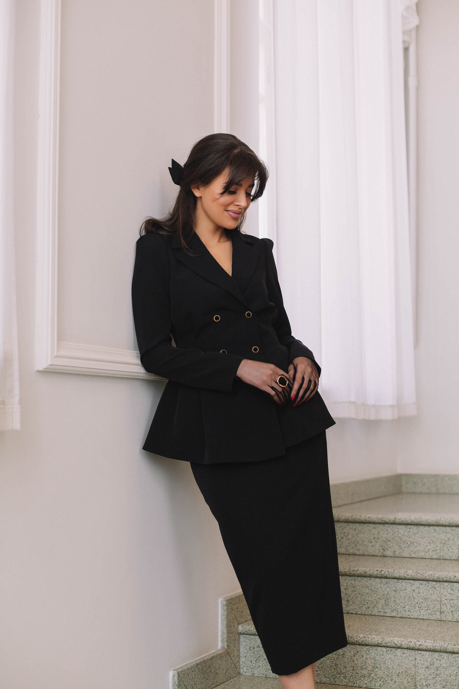


ABOUT ME
Michelle is a passionate digital marketer with a creative flair for content creation and brand strategy. With years of experience in the field, she has helped businesses grow their online presence and engage their audience more effectively.
Michelle loves exploring the latest trends in digital marketing, always staying ahead of the curve to bring innovative ideas to her clients. Outside of work, you can find her enjoying outdoor adventures, practicing yoga, or curled up with a good book.

